Slide 1
REAL-TIME OBJECT DETECTION

Slide 2
CONTENT
INTRODUCTION TO COMPUTER VISION
CHALLENGES IN REAL-TIME OBJECT DETECTION
CUTTING-EDGE OBJECT DETECTION ALGORITHM
IMPLEMENTING REAL-TIME OBJECT TRACKING
INTEGRATING OBJECT DETECTION IN SURVEILLANCE SYSTEMS
ENABLING AUTONOMOUS DRIVING WITH OBJECT DETECTION
IMPROVING RETAIL AUTOMATION THROUGH OBJECT DETECTION
00

Slide 3
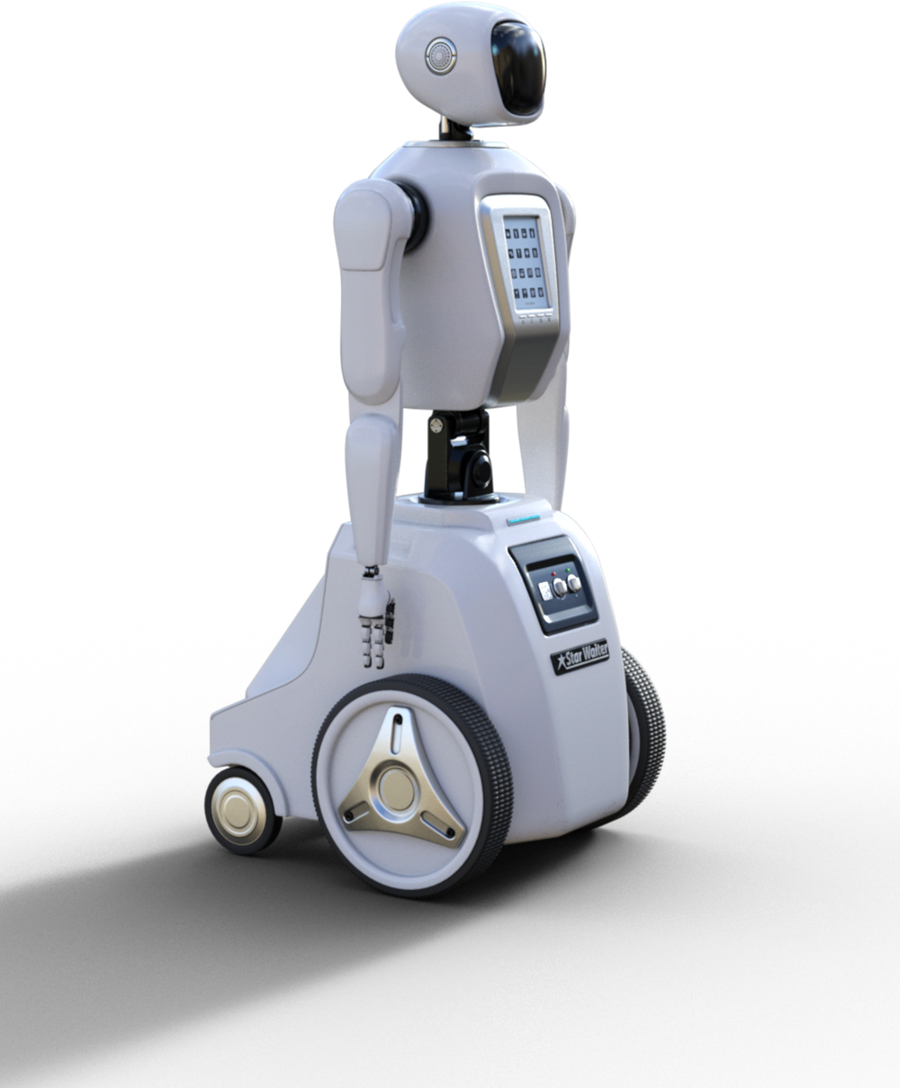
01
THYNK
UNLIMITED
REAL-TIME OBJECT DETECTION
Real-time object detection and tracking are revolutionizing industries from surveillance to autonomous driving. Our cutting-edge AI-powered solutions provide robust and accurate identification and tracking of objects in dynamic environments, unlocking new possibilities for smart cities, safety, and automation.
WWW.REALLYGREATSITE.COM

Slide 4

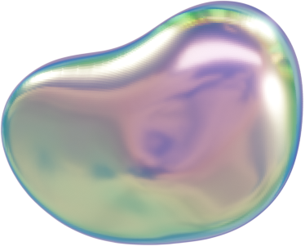
02
THYNK
UNLIMITED
PROBLEM STATEMENT
Develop an object detection model that can accurately detect, classify, and localize multiple objects within an image or video frame.
WWW.REALLYGREATSITE.COM

Slide 5
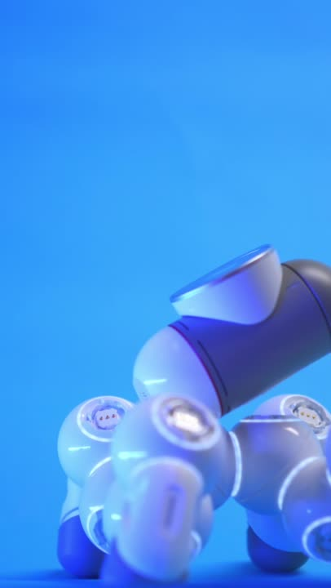
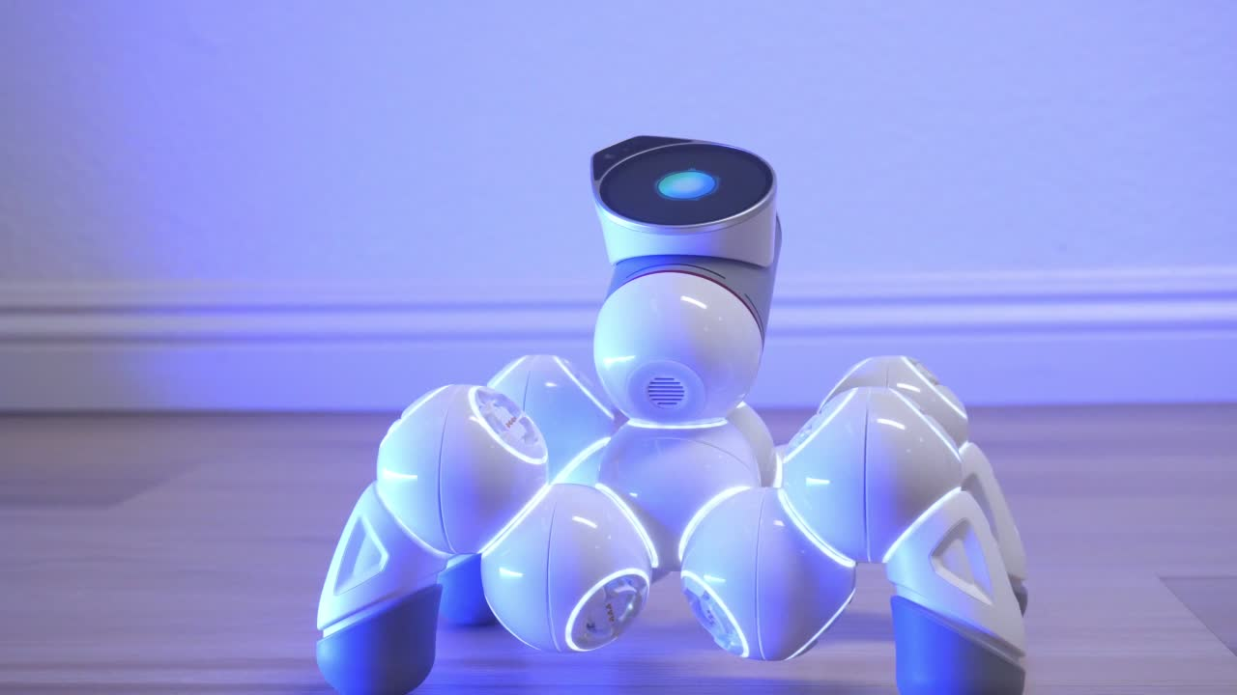
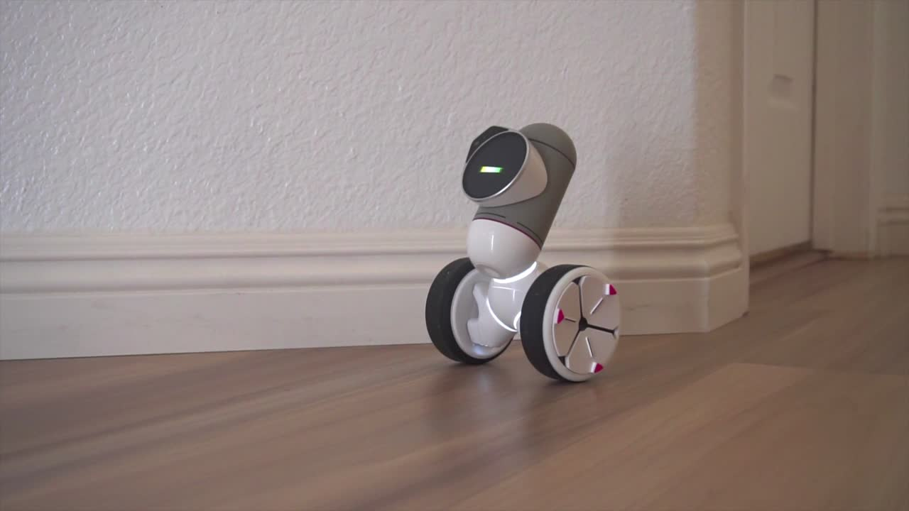
03
METHODOLOGY
computer VISION
OBJECT DETECTION
INTELLIGENT SYSTEMS
Leveraging advanced algorithms to enable machines to interpret and understand digital images and videos.
Object detection is a core capability enabling a wide range of smart applications.
Identifying the location and classifying the type of objects within a visual scene.

Slide 6

04
CHALLENGES IN REAL-TIME OBJECT DETECTION
HIGHACCURACY:
Achieving precise object identification and localization, even in crowded or dynamic scenes
Low Latency:
Enabling instantaneous detection and tracking to support time-critical applications.
Scalability:
Handling large volumes of data and maintaining performance as the number of objects increases
Robustness:
Ensuring reliable performance under varying environmental conditions and occlusions.
\

Slide 7

05
THYNK
UNLIMITED
CUTTING-EDGE OBJECT DETECTION ALGORITHMS
1.Deep Learning Approaches:
Leveraging convolutional neural networks and other advanced machine learning techniques for high accuracy.
2.Traditional Computer Vision:
Combining feature extraction, segmentation, and classification algorithms for robust performance.
3.Hybrid Architectures:
Integrating the strengths of both deep learning and traditional methods for optimal results.

Slide 8

06
THYNK
UNLIMITED
IMPLEMENTING REAL-TIME OBJECT TRACKING
DETECT
Identify the location and class of objects in each video frame
2. ADDOCIATE
Link detected objects across frames to establish continuous tracking.
3. UPDATE
Refine object positions and trajectories based on new information.
WWW.REALLYGREATSITE.COM

Slide 9
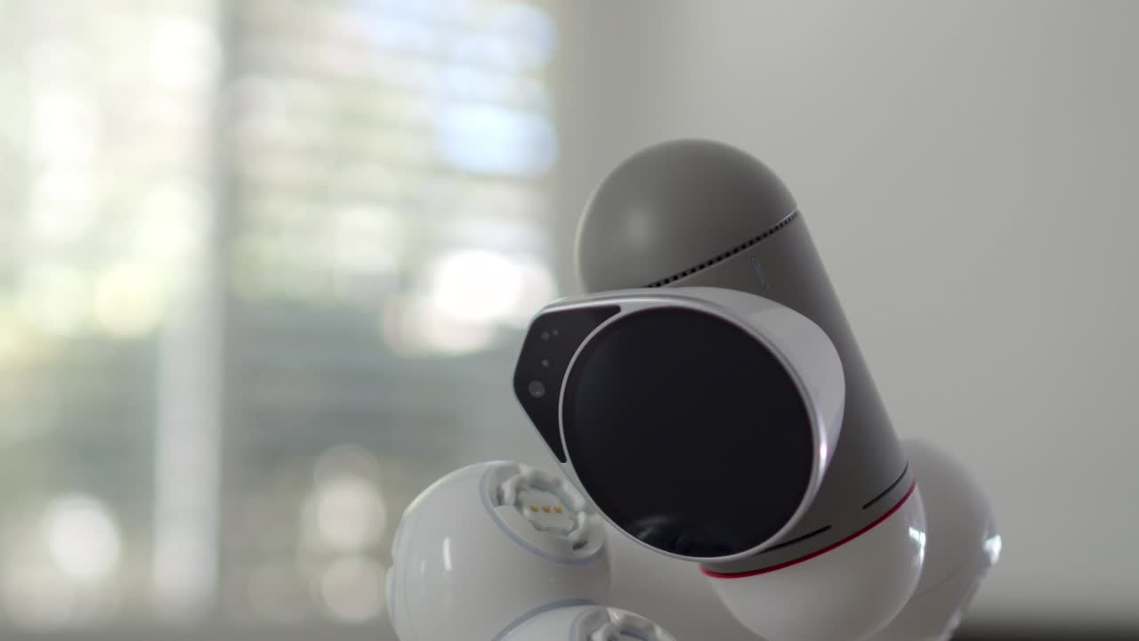
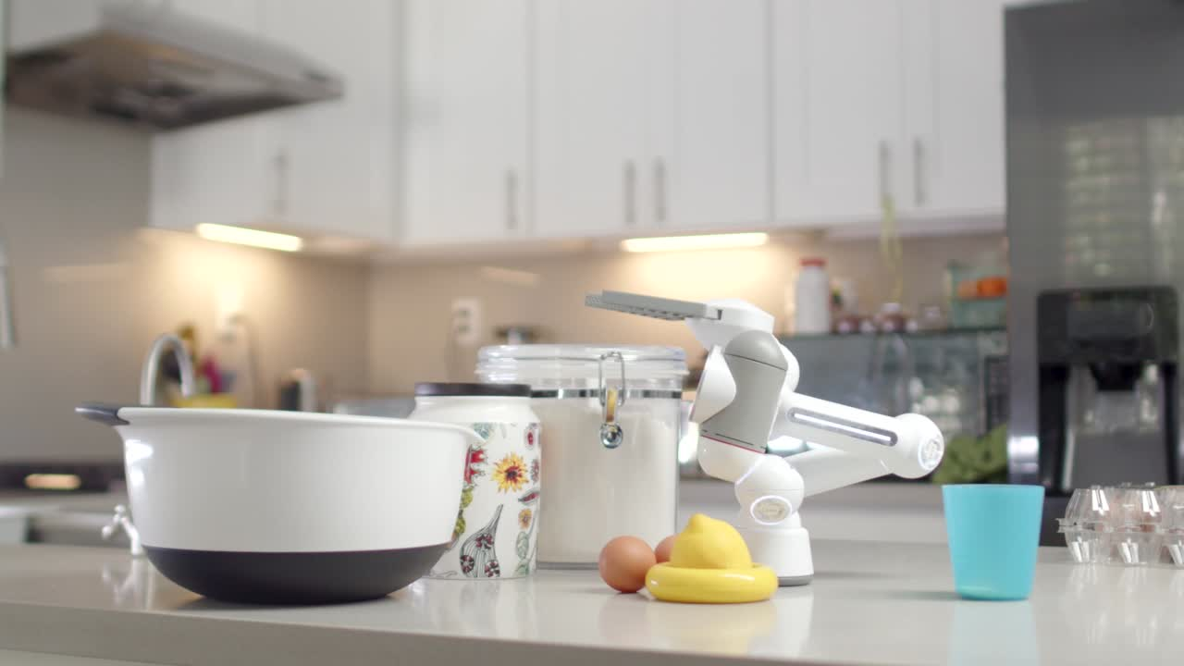
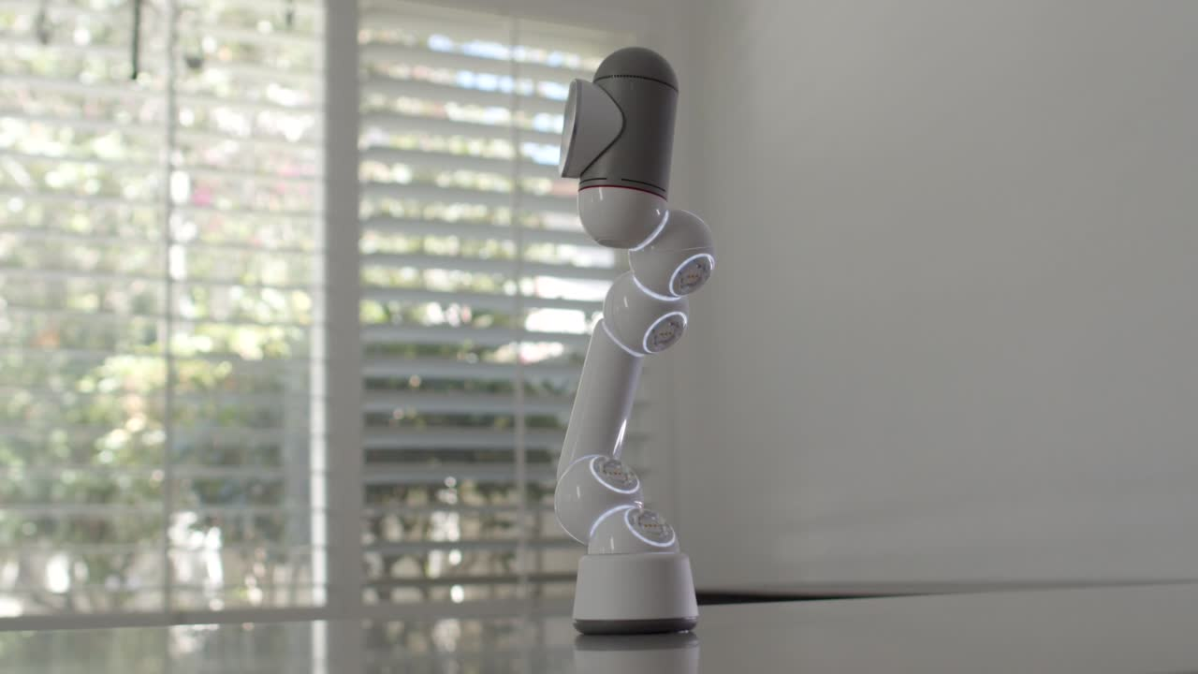

INTEGRATING OBJECT DETECTION IN SURVEILLANCE SYSTEMS
07
Intelligent Monitoring:
Automated detection and tracking of people, vehicles, and other objects of interest.
System Integration
Seamless integration with existing security infrastructure for a comprehensive solution.
:
Threat Detection
:Rapid identification of suspicious behavior and potential security risks.
Data Analytics
Collect and analyze object movement patterns to gain valuable insights.
:

Slide 10

08
THYNK
UNLIMITED
ENABLING AUTONOMOUS DRIVING WITH OBJECT DETECTION
PERCEPTION
Accurately identify and locate all relevant objects in the vehicle’s surrounding
PREDICTION
Anticipate the future movements and behaviors of detected objects.
PLANNING
Develop safe and efficient driving strategies based on the perceived environment.
WWW.REALLYGREATSITE.COM

Slide 11
IMPROVING RETAIL AUTOMATION THROUGH OBJECT DETECTION
Seamless recognition and tallying of items in shopping carts for a frictionless checkout experience.
Continuous tracking of product stocks and automated replenishment notifications.
Automated Checkout
Automated Checkout
Insights into shopper behaviors and preferences to optimize store design and merchandising.
Automated Checkout

Slide 12
THANK YOU
7522982531
contact us
RUDRAWARPARTH99@GMAIL.COM

